Slide 1


Code Coverage
KVS CHARAN [T1735]
A Quest Global Company

Slide 2
What is Code Coverage ?
Code coverage is a metric used in software testing that measures the extent to which the source code of a program is executed when a particular test suite runs.
This indicates how much of the code is covered by tests, helping developers identify areas of their code that are not being tested and potentially contain bugs.
Code coverage is a white-box testing technique performed to verify the extent to which the code has been executed. Code coverage tools use static instrumentation in which statements monitoring code execution are inserted at critical junctures in the code.
The percentage of code coverage is
% Code Coverage = (No of Lines of Code Executed/Total No of Lines of Code in an App)*100.

Slide 3
Types of Code Coverage
We have different types of code coverage techniques. They are
Branch Coverage
Function Coverage
Condition Coverage
Path Coverage
Line Coverage
Loop Coverage
Branch Coverage:
Branch Coverage is a type of code coverage that measures whether each possible branch in the code has been executed during testing.
A branch is defined as any point in the code where the flow can diverge, typically seen in decision-making structures like if statements, switch cases, loops with conditions, and ternary operators.
Branch coverage ensures that all possible outcomes of these decision points have been tested.
It check’s how many of the branches of the control structures (if statements) have been executed.

Slide 4
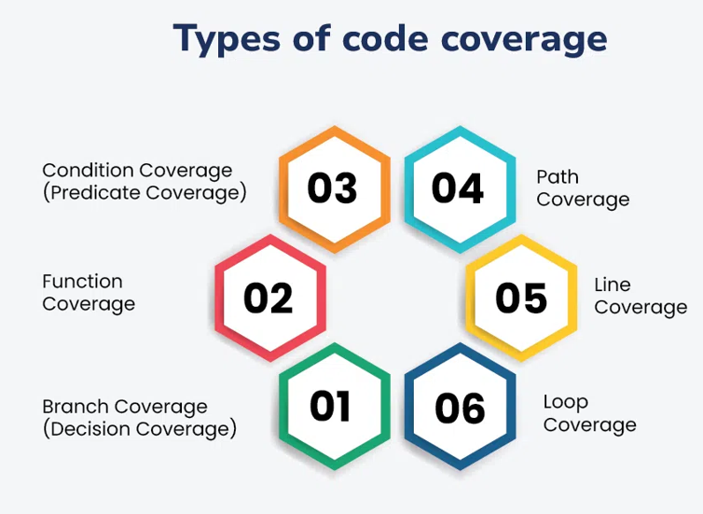

Slide 5
Function Coverage:
Function Coverage is a type of code coverage that measures whether each function or method in a program has been executed during the testing process.
It is one of the simplest and most fundamental forms of coverage, providing a high-level indication of whether your test suite is interacting with all the functions in your codebase.
It tells count that how many of the functions defined have been called.
Condition Coverage:
This measures whether each individual condition (e.g., each boolean expression) has been evaluated both to true and false during testing or not. It tells how many of the boolean sub-expressions have been tested for a true and a false value.
Path Coverage:
Path coverage is defined as the percentage of possible paths of software processing activated by the test cases, so we can test the entire coverage of such an application.
Different paths in a software module are created by choice in conditional statements like IF–THEN–ELSE or DO WHILE or DO UNTIL.

Slide 6
Line coverage:
It checks how many of lines of source code have been tested.
Line Coverage is a type of code coverage metric that measures the percentage of executable lines of code that have been executed by tests.
It helps developers ensure that their tests are hitting the lines of code they intend to test
Loop Coverage:
Loop Coverage is a type of code coverage that specifically targets the execution of loops within a program.
It ensures that loops are properly tested by checking different conditions under which loops are entered, exited, and iterated over.
It’s crucial to test loops because it contain complex logic or are responsible for significant parts of the program's behavior.
References: Atlassian, Google Search and GeeksforGeeks.

Slide 7


